Slide 1

Evaluation of LinDA and comparison with other tools for visualization of Linked Data datasets
Final Presentation
Mentor:
Dr. Fabrizio Orlandi
Michael Galkin
Rose-Mary Owusuaa Mensah
Nishananth Baskaran
Ugochukwu Chimbo Ejikeme
Nikhil Patra
8th April 2015 Semantic Web Lab 1

Slide 2

Outline of presentation
LinDa software Overview
Architecture and summary of evaluation process
Detailed description of the testing strategies
Comparison of LinDa with other visualization tools
Conclusion
8th April 2015 Semantic Web Lab 2

Slide 3
LinDA Software overview
Make benefits of Linked data available to SMEs and data providers
Web browser based generic approach for visualization
Supports data formats such as RDF, CSV
Can be used in various domains and not restricted for use by only technical audience
8th April 2015 Semantic Web Lab 3

Slide 4
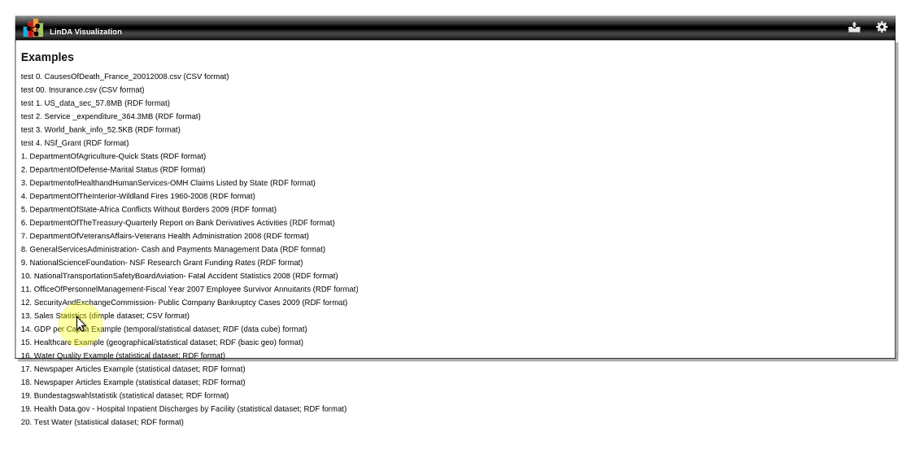
LinDA Software overview
8th April 2015 Semantic Web Lab 4

Slide 5
Architecture of Evaluation process
Software Block
Knowledge Base (Datasets)
Evaluators
Evaluation Module
SPARQL Endpoint
Evaluators
Participant Identification
CSV Files Repository
Evaluation Results
Outline Tasks
Collecting Results
LinDA and other VIZ tools Interface
Questionnaire development
Analysis
Evaluation Criteria
identification
Report Generation
Environment Setup
Feedback
Users
Conduct Study
8th April 2015 Semantic Web Lab 5

Slide 6

Evaluation of LinDA
Six main forms of tests conducted
Two groups of evaluators
Four lab team mates
Twenty test participants
Devices and materials used
Virtual machines, timers
Other visualisation tools
Datasets, questionnaires
Reports generated after each test
8th April 2015 Semantic Web Lab 6

Slide 7


Installability and Efficiency testing: Strategy
Installability test
Conducted by lab members
Software installed on pcs and EIS workstations
Outcome: Installability test report
Efficiency test
Setup two virtual machines
VM differed in memory sizes and number of processors
Analyzed the behavior of the software with respect to resource consumption based on datasets
8th April 2015 Semantic Web Lab 7

Slide 8
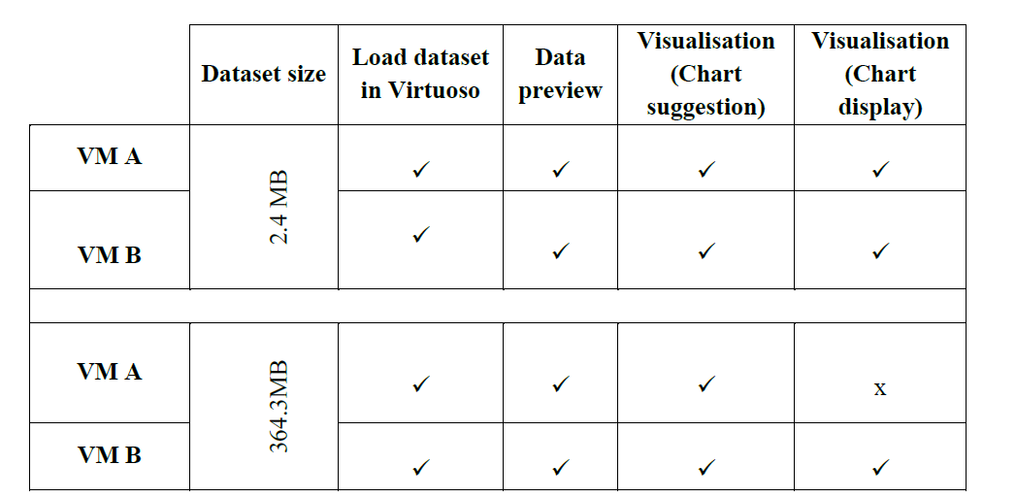
Efficiency testing: Results
Memory sizes
VM A: 2885MB
VM B: 7642MB
8th April 2015 Semantic Web Lab 8

Slide 9

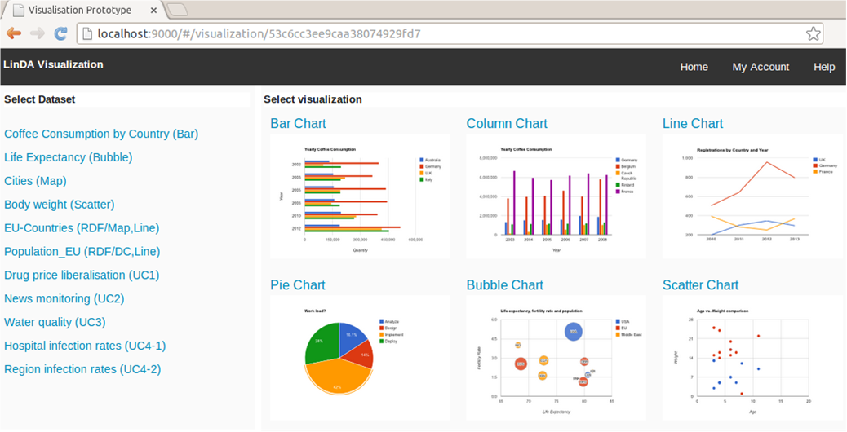
Scalability and Effectivity testing: Strategy
Scalability test
Different formats and sizes of datasets
Outcome: Scalability test report
Effectivity test
Uploaded seven datasets with various formats such as .ttl, .n3, .rdf, .csv
Visualized datasets and analyzed the results
Outcome: Effectivity test report
8th April 2015 Semantic Web Lab 9

Slide 10
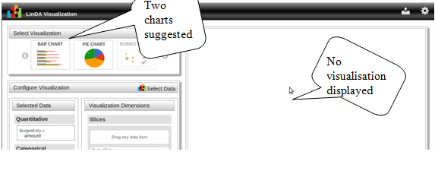
Scalability testing: Results
Incomplete Scenario. Charts are suggested but not displayed. VM out of memory
8th April 2015 Semantic Web Lab 10

Slide 11
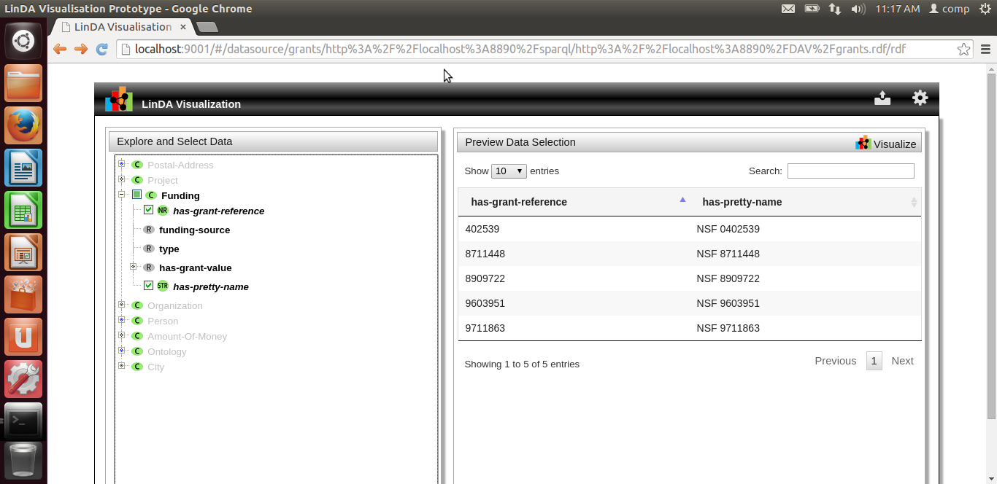
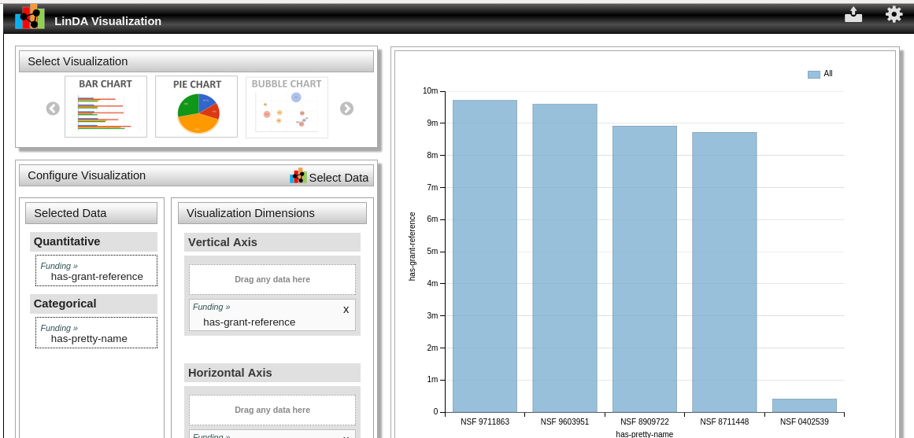
Effectivity testing: Results
Screenshots of sample dataset (NSF standard grant) visualized in LinDA.
8th April 2015 Semantic Web Lab 11

Slide 12

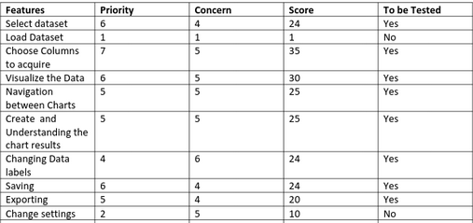
Usability testing: Strategy
Usability test
20 participants ranging from experienced to novices, 5 Male and 15 Female.
Age group 20-30
17 students, 2 PhD and 1 working
VMs, datasets, test cases and questionnaires available for users
Prioritizing features by cognitive walkthrough by expert user
Background scenario
3 levels of support
8th April 2015 Semantic Web Lab 12

Slide 13
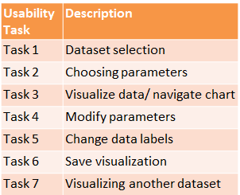
Usability testing: Results
8th April 2015 Semantic Web Lab 13

Slide 14
Usability testing: Results
8th April 2015 Semantic Web Lab 14

Slide 15
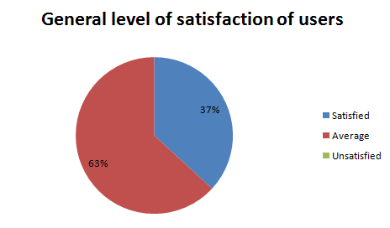
Usability testing: Results
8th April 2015 Semantic Web Lab 15

Slide 16


Conclusion: Usability Study
The good
Simple UI
Clear visualizations
Different chart types
The “Not too good”
Misleading labels
Poor arrangement of datasets
Scaling of axis impossible
8th April 2015 Semantic Web Lab 16

Slide 17





Comparison of LinDa with other Visualisation tools
8th April 2015 Semantic Web Lab 17

Slide 18
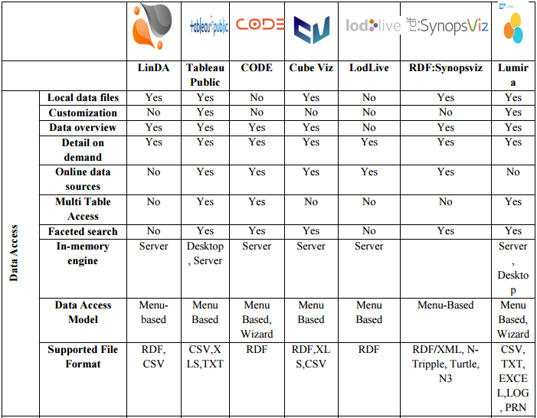
Comparison with other visualization tools
8th April 2015 Semantic Web Lab 18

Slide 19
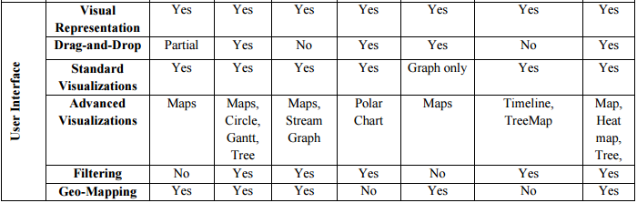
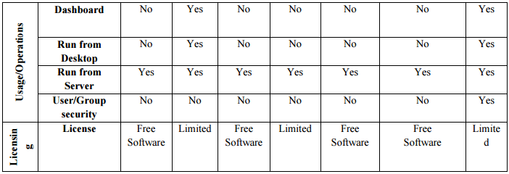
Comparison with other visualization tools
8th April 2015 Semantic Web Lab 19

Slide 20

8th April 2015 Semantic Web Lab 20

Slide 21

Questions and Answers
8th April 2015 Semantic Web Lab 21

